Slide 1
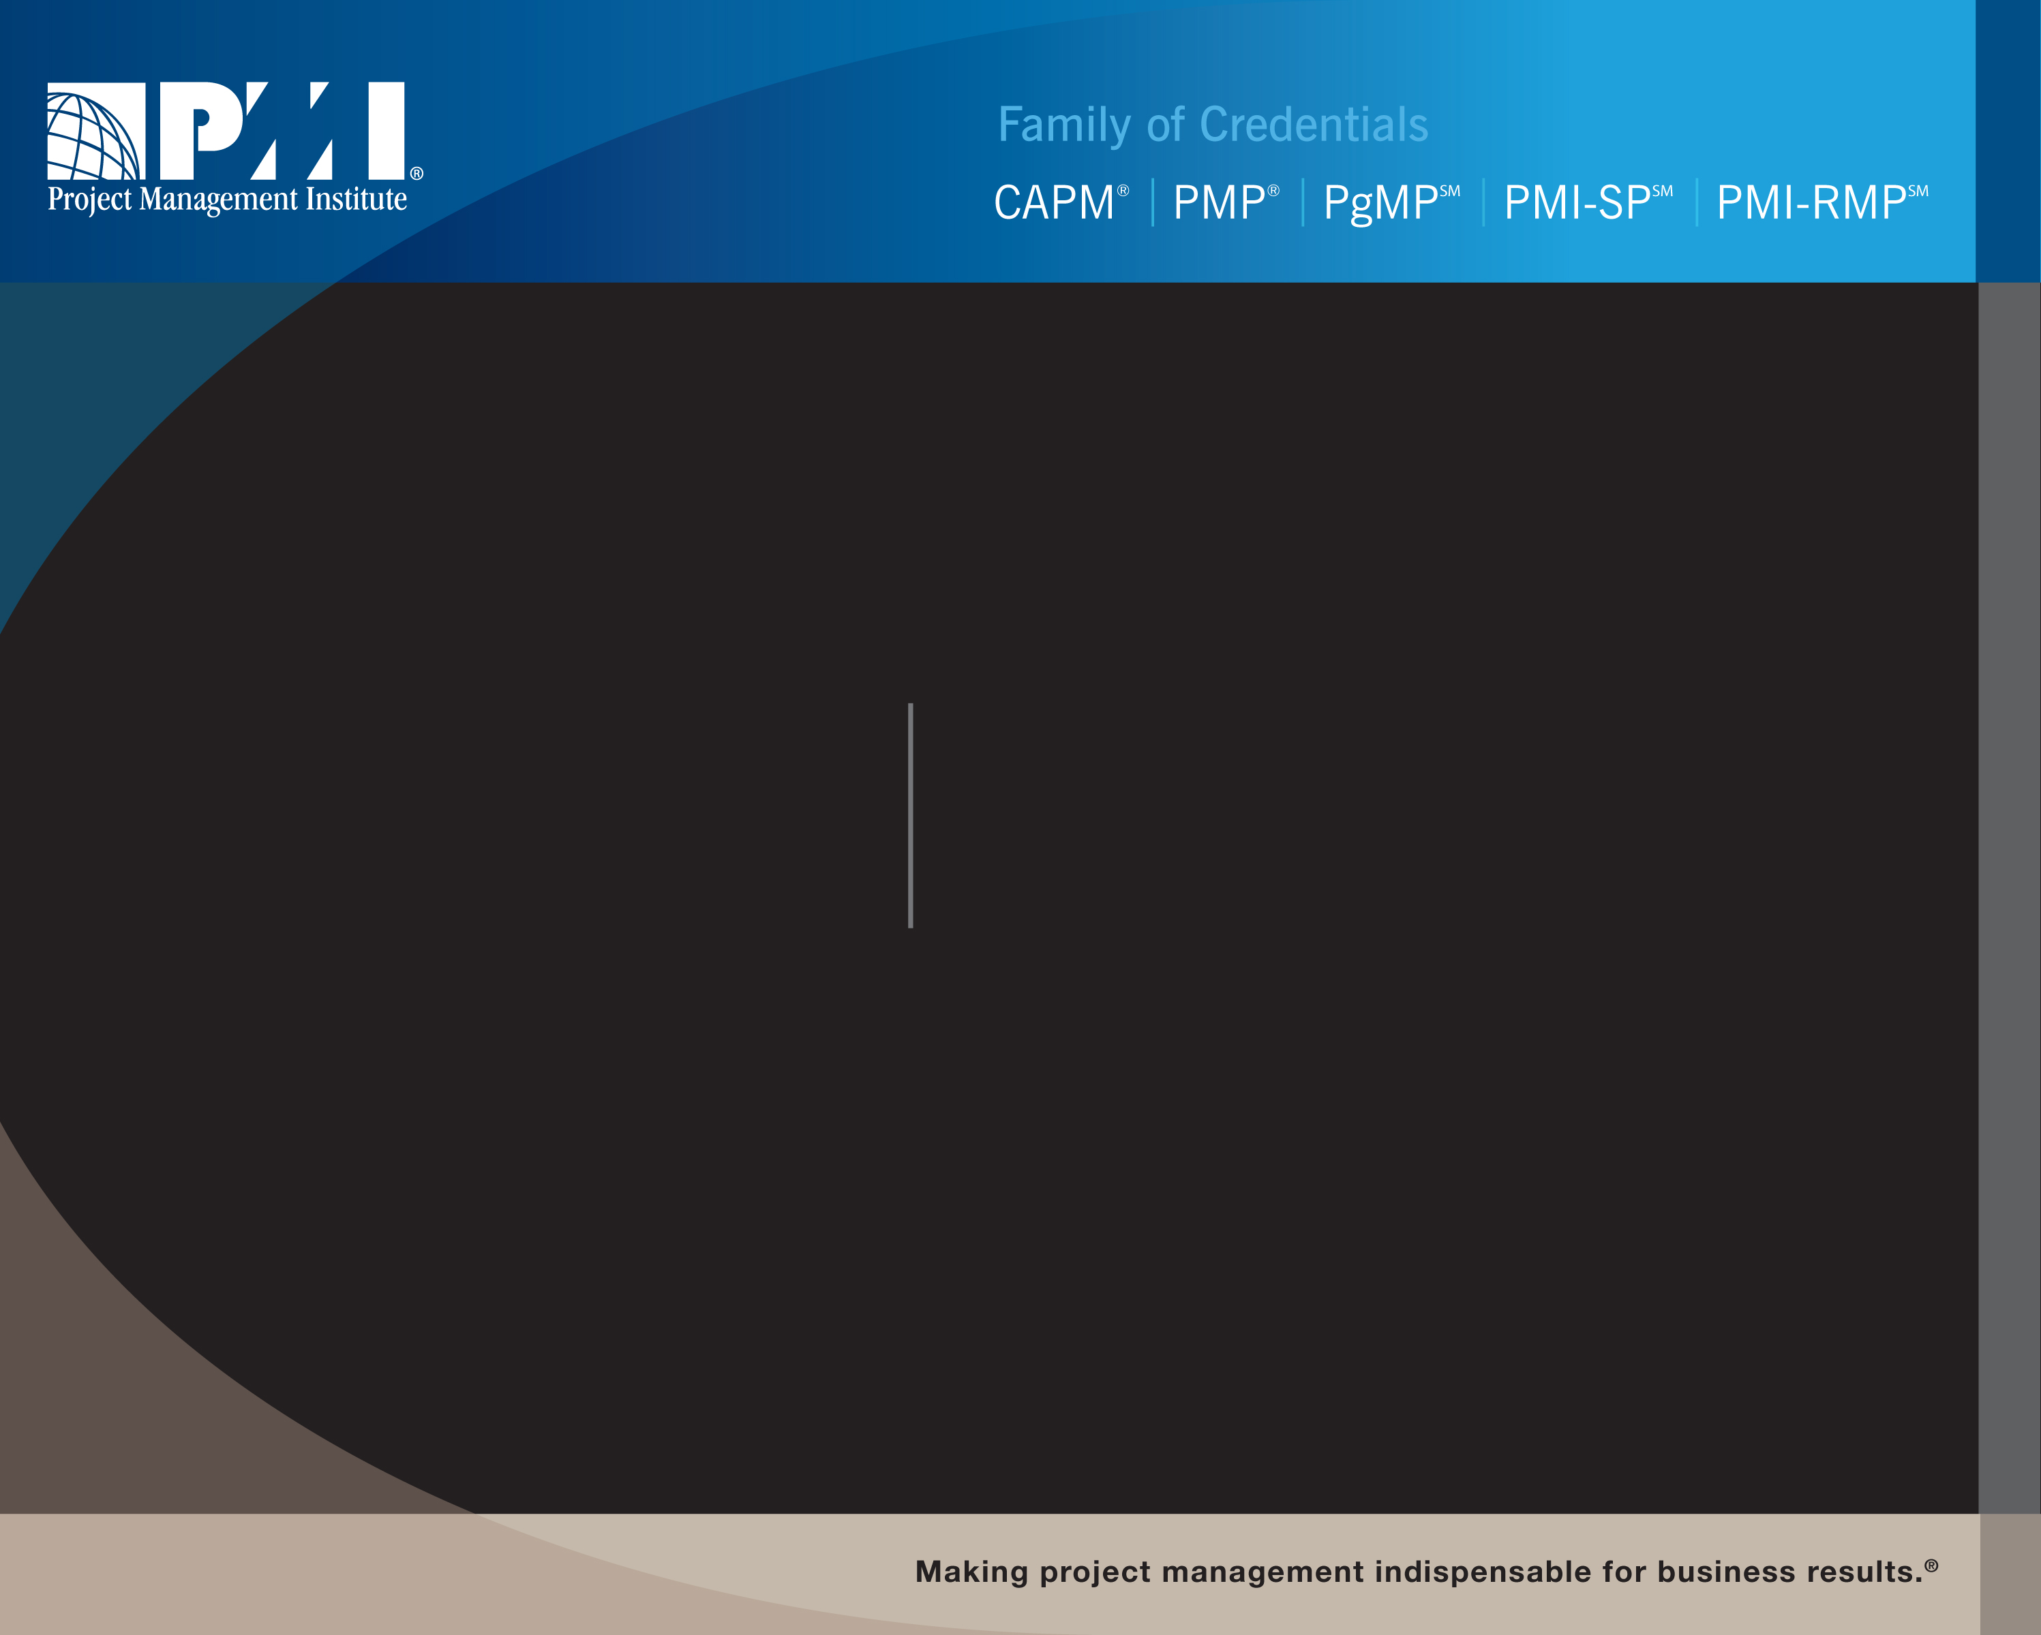
PMI Specialty Credentials:
PMI-SP and PMI-RMP
PMI Chapter Name

Slide 2
Why Did PMI Release Specialty Credentials?
In a 2004 market research survey of members and credential holders, both project scheduling and project risk management ranked in the top three list of demands for a specialty credential
In a 2006 survey of project scheduling and project risk management practitioners:
  68% agree/strongly agree that a professional certification for project scheduling practitioners would be valuable to the project management profession
  65% agree/strongly agree that a professional certification for project risk management practitioners would be valuable to the project management profession

Slide 3
What Are The New Specialty Credentials?
The PMI Scheduling Professional (PMI-SP)SM and the PMI Risk Management Professional (PMI-RMP)SM credentials are additions to the PMI Family of Credentials including the PMP®, CAPM® and PgMP®
Globally developed and applicable credentials
Require no prerequisite credentials - independent of the PMP or any other PMI credentials
Recognizes those who perform the role of a project scheduler or project risk management practitioner

Slide 4
What Is The PMI-SP?
A PMI-SP provides expertise in the specialty area of developing and maintaining the project schedule
Candidates who achieve the credential support project management and the project team as a dedicated contributing member
  Not a certification in using a project scheduling tool
Requires a minimum of three years of project scheduling experience
Features a 3.5 hour, 170-question examination
The credential examination is not written to the standard, it is written to the role of a project scheduling practitioner
  The standard is one of multiple references in the project scheduling body of knowledge
Notes:
Competitive Information
PSP – AACEI’s Planning and Scheduling Professional (Certification)
Needs 8 full years of experience (4 years of college can be substituted)
Documentation of experience and education
7-hour exam
- measures knowledge, experience and adherence to best practices

Slide 5
What Is The PMI-RMP?
A PMI-RMP provides expertise in the specialty area of assessing and identifying project risks along with plans to mitigate threats and capitalize on opportunities.
Candidates who achieve the credential support project management and the project team as a dedicated contributing member
Requires a minimum of three years of project risk management experience
Features a 3.5 hour, 170-question examination
The credential examination is not written to a specific standard, it is written to the role of a project risk management practitioner
Notes:
Competitive Information
PSP – AACEI’s Planning and Scheduling Professional (Certification)
Needs 8 full years of experience (4 years of college can be substituted)
Documentation of experience and education
7-hour exam
- measures knowledge, experience and adherence to best practices

Slide 6
Benefits To The Organization
Supports the roles performed by professionals who contribute to organizational growth and maturity through project management practices
Impacts bottom-line results
  Projects are completed on time, on budget and within scope
Talent Management
  Provides career development opportunities for employees
    Defines a role and skill set
    Consistent standards of employee performance
    Recognition for hiring and advancement
Attracts better qualified employees (ROI on human resources)

Slide 7
Benefits To The Credential-Holder
Validates a formal role and level of expertise
Increases the practitioner’s marketability
Establishes a career development opportunity
Provides role differentiation
Establishes critical skill requirements

Slide 8
PMI-SP Eligibility Requirements
Type of Degree | Formal Education | Experience
Bachelor’s or global equivalent | 30 contact hours | 3,500 hours within the past five years
High school diploma or global equivalent | 40 contact hours | 5,000 hours within the past five years
Both formal education and experience must
be in project scheduling.

Slide 9
PMI-RMP Eligibility Requirements
Type of Degree | Formal Education | Experience
Bachelor’s or global equivalent | 30 contact hours | 3,000 hours within the past five years
High school diploma or global equivalent | 40 contact hours | 4,500 hours within the past five years
Both formal education and experience must
be in project risk management.

Slide 10
Examination Fees (Both Credentials)
Computer-based Testing (CBT)
Description | Member Fee | Non-member Fee
Exam | US$520 | US$670
Refund | US$250
Retake | US$335 | US$435
Refund | US$125
Paper-based Testing (PBT)
Description | Member Fee | Non-member Fee
Exam | US$415 | US$565
Refund | US$250
Retake | US$270 | US$370
Refund | US$125

Slide 11
PMI-SP Examination Specification
The PMI-SP examination is developed based on the examination blueprint contained in the PMI–Scheduling Professional Examination Specification. The examination blueprint details the percentage of questions contained in each project scheduling domain.
Domains Tested: Percent
  Schedule Mission Management 9%
  Schedule Creation 23%
  Schedule Maintenance 23%
  Schedule Analysis 22%
  Schedule Communication/Reporting 23%
  TOTAL 100%

Slide 12
PMI-RMP Examination Specification
The PMI-RMP examination is developed based on the examination blueprint contained in the PMI–Risk Management Professional Examination Specification. The examination blueprint details the percentage of questions contained in each project scheduling domain.
Domains Tested: Percent
  Risk Communication 27%
  Risk Analysis 30%
  Risk Response Planning 26%
  Risk Governance 17%
  TOTAL 100%

Slide 13
Credential Maintenance (CCR)
The credential holder must meet these Continuing Certification
Requirements:
Obtain 30 Professional Development Units (PDUs) per three-year cycle
Ensure PDUs are in the specialty area of project scheduling/project risk management
  The 30 PDUs for either specialty credential can also be counted towards the maintenance of the PMP® or PgMP® credential(s)
  If a PMI-SP/PMI-RMP is taking general project management classes, ONLY the hours that pertain to project scheduling or project risk management can be applied towards the specialty credential
Can obtain PDUs through same sources as other credentials

Slide 14
Credential Resources
PMI-SP/PMI-RMP Handbooks
PMI-SP/PMI-RMP Examination Specifications
www.PMI.org/scheduling
www.PMI.org/risk
Contains information on:
    Eligibility
    Important Dates (for applying and scheduling examination)
    Resources related to project scheduling and project risk management
    Testimonials
    FAQs
    Links to apply on-line

Slide 15
Marketing Messaging
Some of Executives biggest concerns: cost and schedule overruns
  Those who hold PMI-SP are qualified and can mitigate issues
2008 research commissioned by PMI and conducted by Economist Intelligence Unit (EIU) states:
  Project risk identification and mitigation identified as key to company performance over the next five years
Provides recognition for those who perform the specific role of a project scheduler/project risk management practitioner
Career path and development opportunities
Establishing a pool of new project management practitioners (carving out the market niche –project scheduling and project risk management)

